Slide 1
Week 5

Slide 2
Code Refactor
Some attributes were associated with the wrong classes
Some classes were too restrictive making the processing awkward
Moved around the processing of some things to make things more flexible and consistent

Slide 3
Animations
Integrated properly into the structure, can be created from the main interface
Added as a feature to the plotter tool
Titles have been made more sane
Colorbar range is fixed across the animations
Why splines are unnecessary

Slide 4
Identifying Time Series
Animations were a lot to process
Identifying time series based on metrics that are only a function of the time series
Currently using the mean, standard deviation, and standard deviation divided by the mean
What other more complicated heuristics of interesting could I use?

Slide 5
Plan for Analysis
Identify a handful of interesting case studies, perhaps four
Each would have some distinct reason why they were interesting
Potential reasons:
Very consistent (small standard deviations)
Large amounts of crime (middle standard deviations)
Very inconsistent (large standard deviations)
Sudden change in time behaviour

Slide 6
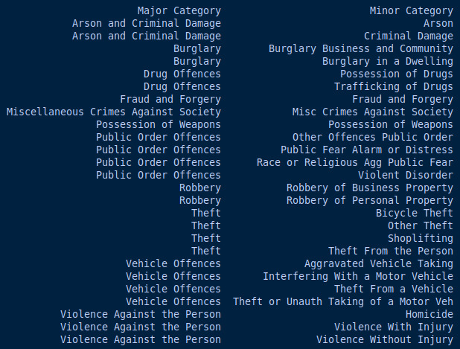

Slide 7
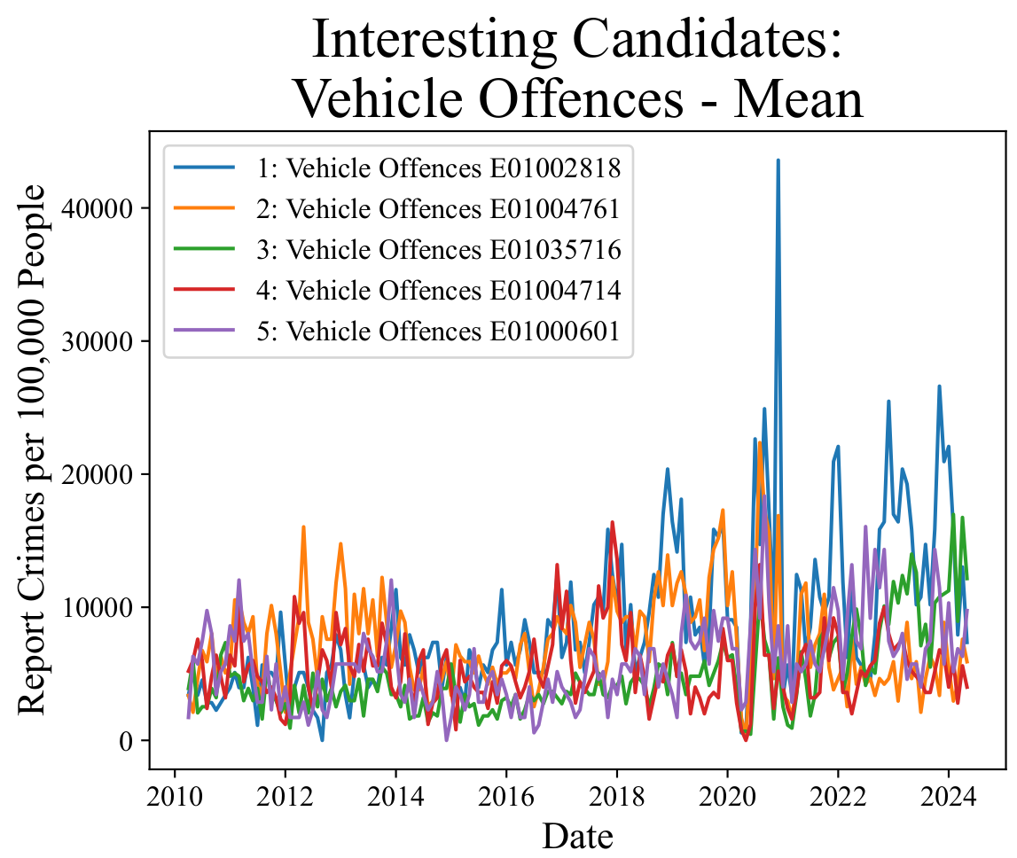
Interfering With a Motor Vehicle
Theft From a Vehicle
Theft or Unauth Taking of a Motor Veh

Slide 8
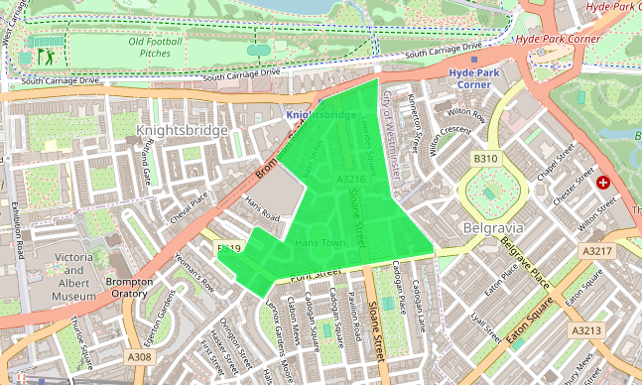

Slide 9
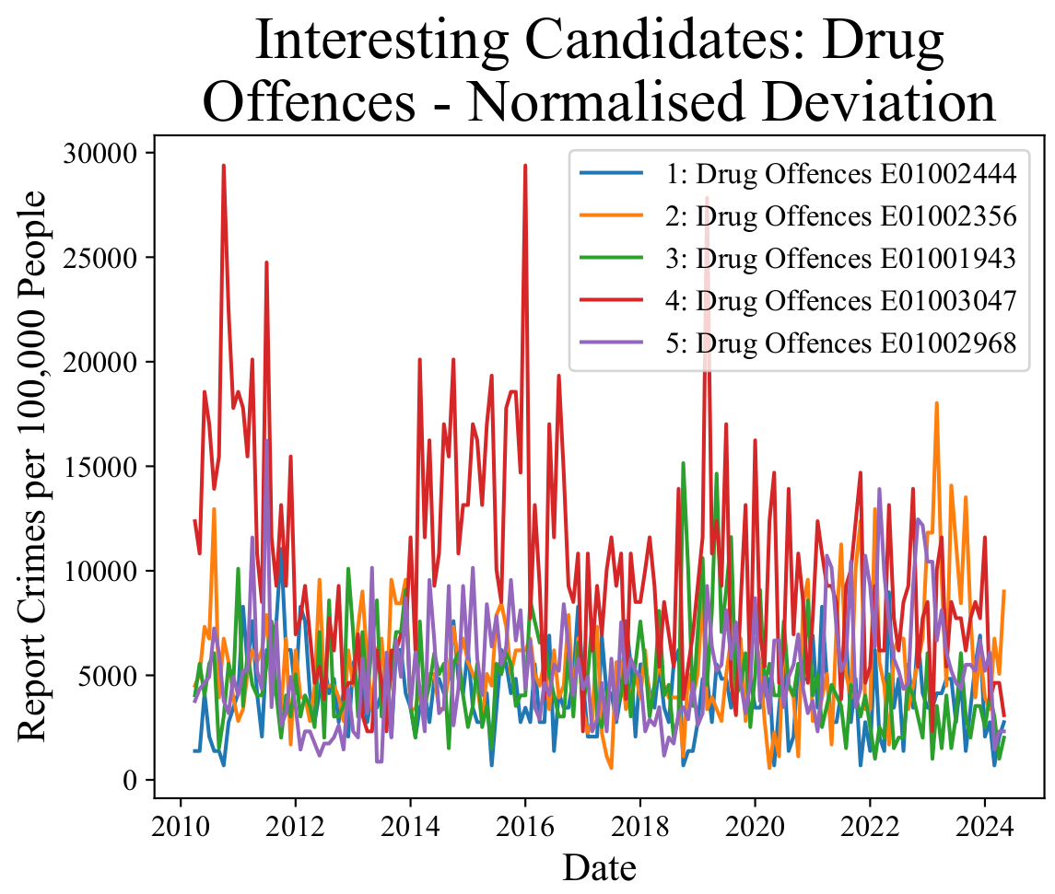

Slide 10
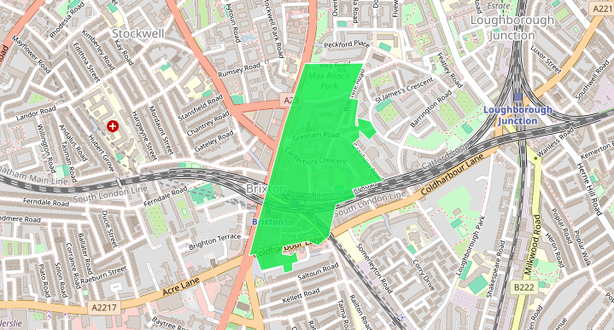

Slide 11
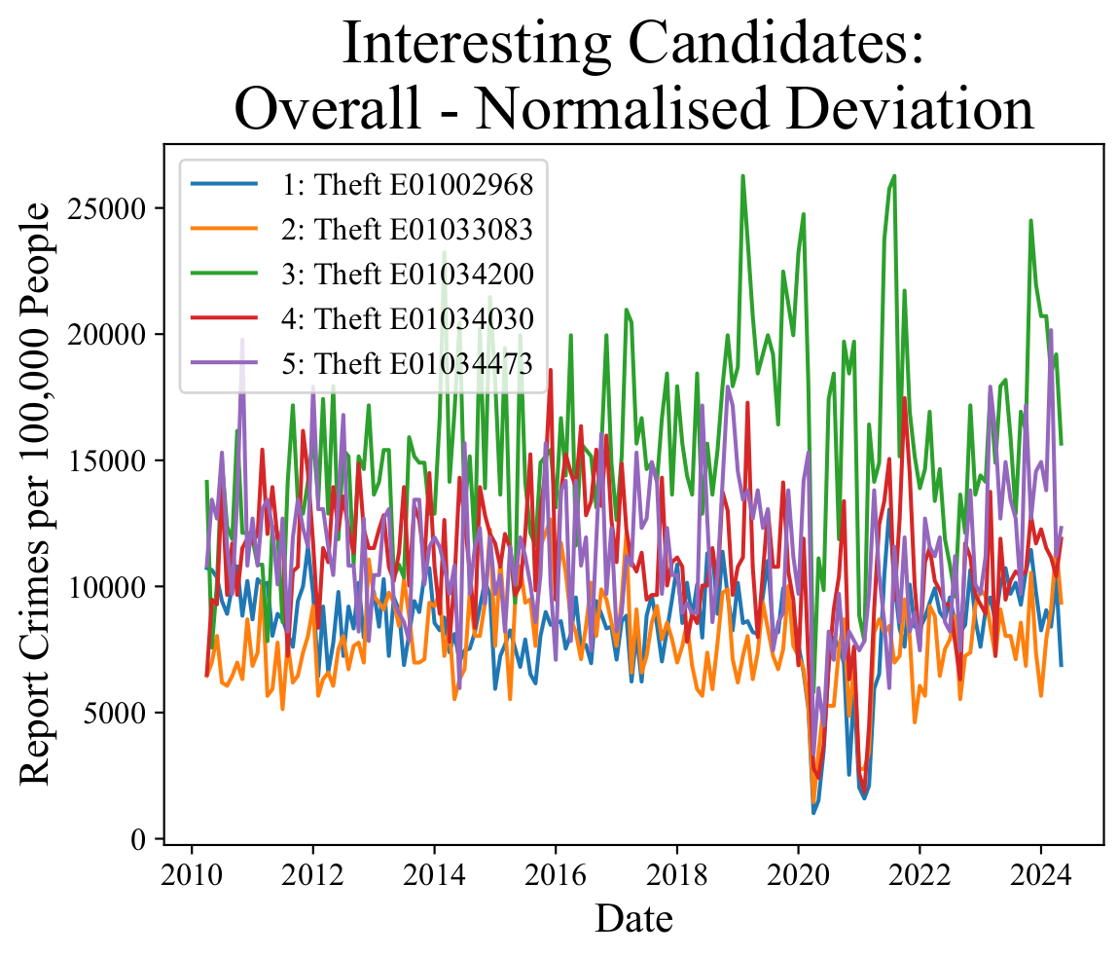

Slide 12
Updated Plan
Week 6: Identify interesting time series case studies to look at and start developing ARIMA and LSTM toolkits
Week 7: Finish developing ARIMA and LSTM for time series, and start exploring with these toolkits
Week 8: Create more detailed structure of the results part of the paper, and preparing figures from experiments. Start writing
Week 9: Finish main writing of results
Week 10: Conclusions, introduction, abstract, formatting
Week 11: Tidying up and starting work on presentation materials
Week 12: Slack week

Slide 13
If I have more time
- Look into LSTM that uses surrounding spatial data
- Test for non-stationary variance and explore GARCH models
- Do annoying formatting for two columns

